Slide 1
Nearest Province Finder
Jiaqi Zhang, Wenqiang Yang

Slide 2
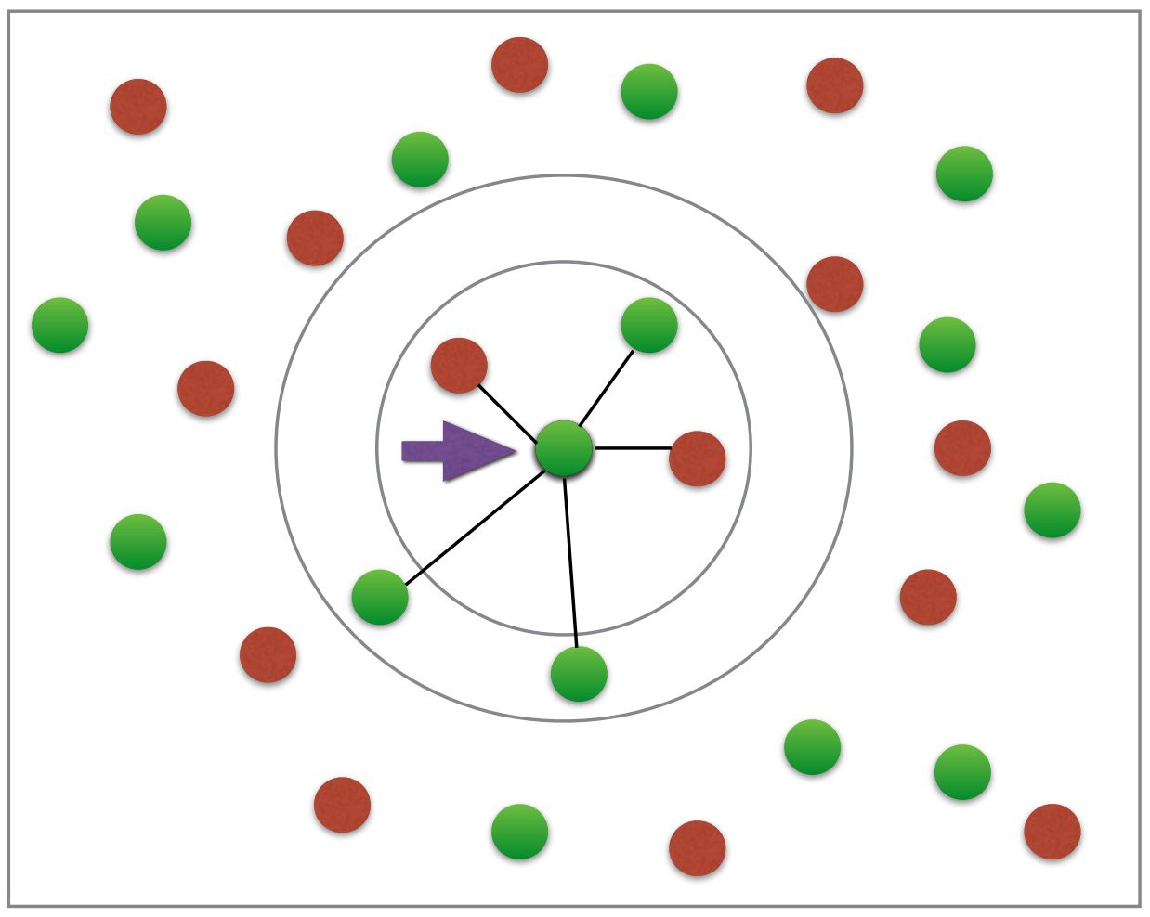
Background
- large number(70 MB) of reference points in the US
- return nearest K reference points
- find the state and county of the point by majority voting

Slide 3
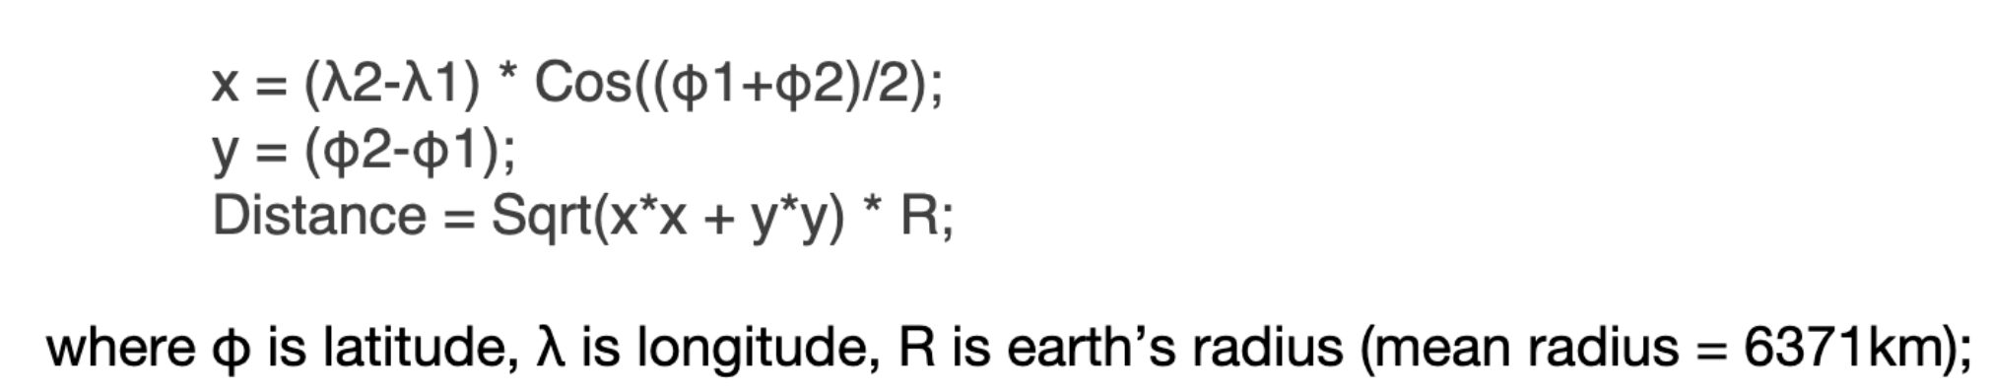
Equirectangular Approximation

Slide 4
Possible Algorithm/Data Structure
Brute force (Heap)
K-d Tree
Ball Tree

Slide 5
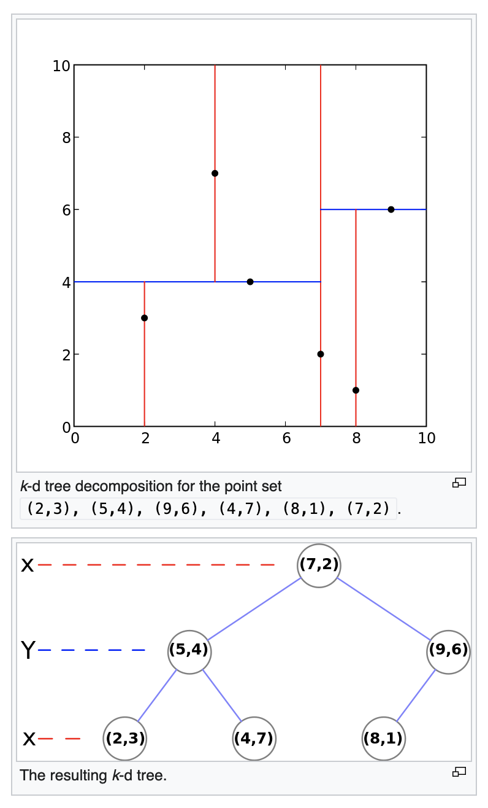
K-d tree
A BST-like efficient data structure to store k-dimensional data
Build tree
Pick a node as root and one dimension, e.g. x axis
Nodes with a smaller x value is in the left subtree, node with a greater x value in the right
Time complexity: average O(nlogn)
Query the nearest k: Depth-first search with pruning
Heuristic algorithm to improve pruning efficiency?
Use latitude and longitude to calculate the distance, might be a problem?
https://en.wikipedia.org/wiki/K-d_tree

Slide 6
Tentative Plan
Language: C++
Command line user interface for loading reference points and query
Optimize the pre-processing performance, query performance and memory usage

